Slide 1
Publishing scientific research in journals, conference proceedings, books

Slide 2
Publishing Principles

Slide 3
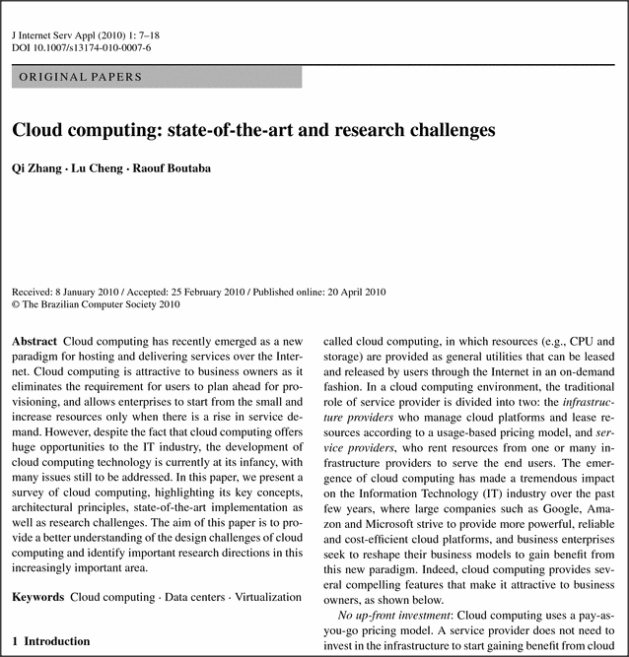
Why publish? To exchange ideas globally
Present new and original results or methods
Advance (not repeat) scientific knowledge and enhance scientific progress
Credibility of results
Grant writing, research funding
Recognition and career advancement
Personal prestige, satisfaction and enjoyment
Your obligation/duty as a scientist!

Slide 4
Why publish in English?
The international language of science
Other scientists WANT to hear from you!
Allows you to become an effective science communicator
To know about progress in your area

Slide 5
Why not just blog about your work?
Scientific publishing ensures:
Quality control
Professional publishing services (e.g. Abstracting & Indexing )
Innovative publishing technology (POD/PTO, XML)
Global marketing, global visibility

Slide 6
Publications in Springer

Slide 7
Journals

Slide 8
Springer’s role in the journal value chain
300,000+ article submissions per year
100,000 reviewers
Solicit and manage submissions
Manage peer review
4.8 million articles now available
6,000 editors and 50,000 editorial board members
Archive and promote
Edit and prepare
Publish and disseminate
Production
130 million downloads from 10,000+ institutions per year
150,000 new articles per year

Slide 9
What do journal editors want?
Good quality science!
Topic that fits into journal‘s scope
Original research
Active research area (creates discussions and citations)
Peer review with feedback
Clear, concise writing
Sufficient command of English language

Slide 10
What do authors want ?
How important are the following factors for you when deciding to submit a manuscript to a particular journal?
Top 1 Box (very important; in percent)
The journal's reputation
Quality of journal's papers
Quality of peer review
International scope
Speed of publication
Impact Factor
Electronic submission system
Coverage by major A&I
Readership
Advanced online publication
Editors / editorial board
Prior experience with this journal
Design / layout
"Author pays" open-access model
(N = 19,220 respondents, 5-point rating: 1=very important to 5=not important at all) Results 2009

Slide 11
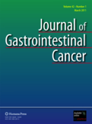
Journal Selection

Slide 12
Some tips on journal selection
Read the journal product page and READ THE JOURNAL.
Talk to your colleagues / peers about their experiences with journals you are considering (did they get visibility and citations)
Make use of the expertise of your Library staff.
Is an Impact Factor important to you? Or are you more concerned about usage/visibility?
Don’t miss the importance of social networking sites.
Join other relevant online groups and forums.
Use the digital libraries, Abstracting & Indexing (A&I) services, Online Archives, etc.
Check publisher sites, you can often find useful information in the ‘for authors’ section.
Avoid journals with no clear submission and reviewing process

Slide 13
How to structure your article
Title | Read first and most. Keep it short and to the point. Must reflect the content of the paper.
Authors | Correct spelling, consistency in affiliation.
Abstract | 75-250 word summary of objective and results. Includes key message of paper.
Keywords | Synonyms relevant as search terms e.g. in Google. Ideally not words from title because title words are automatically keywords.
Introduction | Explain i) why the work was conducted ii) what methodology was employed iii) why you chose this particular methodology iv) How the methodology accomplished the hypothesis set out in your abstract.
Methodology | Written clearly and concisely so that someone can follow what you did.

Slide 14
How to structure your article (cont.)
Analysis/Results | Present the results clearly and carefully.
Discussion | Discuss the results here. If the results were not what you were expecting this is where you can provide insights or speculations as to what happened and/or what you could have done differently.
Conclusions | Write down your conclusions from the study.
Acknowledgements | Acknowledge the people and institutions who have made your research possible e.g. funding.
References | Properly cite your referenced material; use the style of the journal.
Supplementary Material | List any supplementary materials, appendices.

Slide 15
The ‘write’ order
For maximum clarity and consistency, write your manuscript in this order:
Methods Results | Write during the research
Introduction Discussion | Write after selecting your target journal
Title Abstract | Write last

Slide 16
How to submit – dos and don’ts
Do not start writing just a few days prior to the intended submission date
Do ask your colleagues for proofreading and comments before you submit
Do read the guidelines for the journal very carefully and make sure that you conform to these.
Do not contact editors or EB members asking to suggest a journal, do your research on journals FIRST!
Do prepare a cover letter which explains why you think your paper falls within the scope of the journal and which outlines the paper’s originality and/or significance (if asked for in the journal’s guidelines)

Slide 17
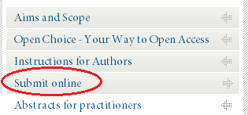
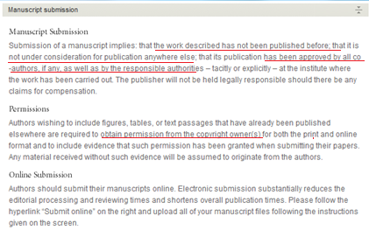
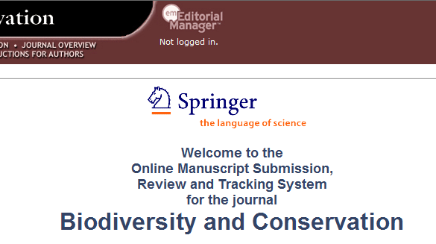
Submission considerations – ethics
The work described has not been published before.
It is not under consideration anywhere else.
Publication has been approved by co-authors and responsible authorities.
Permissions obtained from copyright owners.
Plagiarism
Data fabrication and falsification

Slide 18
Peer review - What is it and why is it important?
Peer review is the process of having other experts in the field evaluate your article, your research and methodology, to determine if your paper is suitable for publication.
Peer review is employed to maintain a high quality standard of published papers and to provide credibility.

Slide 19
Peer review - How to deal with feedback
Nearly every manuscript requires revisions, often two or three revisions.
Consider peer review feedback as advice to help you improve your article.
Address all comments carefully. Write a response letter explaining how you modified the paper to address the comments.
Minor revision does not guarantee acceptance after revision.
Do not be disappointed if you receive a rejection.
Do not start arguing or fighting about review comments.
Very few manuscripts are accepted without any form of
revision
Rejection and revision are integral to the peer review
process

Slide 20
Publishing timeline
Submission to publication, 3–12 months
Manuscript submitted
Editor assigned rapid rejection or peer review
Editor sources reviewers
Reviewers evaluate accept
Reviewers evaluate accept, reject or revise
Revise manuscript
Publication!

Slide 21
How to measure quality - numbers
Impact Factor: number of citations divided by the number of articles
How to measure quality - other factors
Acceptance rate
Quality and duration of peer review
Speed of publication
Global distribution and long-term archiving

Slide 22
Impact Factor
There is much debate over Impact Factors in the scientific community, particularly with regard to the fairness of the system. However, there is no doubt that an Impact Factor is seen as a benchmark of quality of the journal in many academic communities.
Formula for the 2012 Impact Factor:
Number of citations in 2012 to articles published in 2010 + 2011
------------------------------------------------------------------------------------
Total citable articles published in 2010 + 2011
Example:
120 citations in 2012 (to articles published 2010 2011)
------------------------------------------------------------------------------ = 1.5
80 articles published in 2010 and 2011

Slide 23
Impact Factor - Points to consider
Discipline specific – does the subject lend itself to citations?
How big is the field? What is the number of scientists who research and write in a particular area?
Other factors influence the formula e.g. number of issues published per year
How “hot” the topic is

Slide 24
Last but not the least ....
Books

Slide 25
Books vs. Journals
Academic books have a different purpose from academic journals
An academic book is a complete scholarly work on a specific topic
Book chapters fulfill a similar role to review articles, with books representing a collection of manuscripts on related topics
By contrast, review articles published in journals are usually unrelated to all of the other articles in the same issue
Book includes large bibliography, recommended readings, summaries, exercises, index

Slide 26
Different types of books
Monographs
Edited Volume
Textbook
Professional Texts
MRW – Major Reference Works
Handbooks (Springer Reference)
SpringerBriefs
SpringerTheses
Popular Science
...also proceedings

Slide 27
I have an idea for a book…
What type of book shall I write?
How do I get started?

Slide 28
How to prepare a book proposal
a short (3-5 pages, no special format) description of the planned book, its aims & scope, main emphasis, main target group (and how this group will benefit from the book), prerequisites needed to understand the book, and its relation to other publications in the area (if there are any).
a table of contents, incl a rough page estimate and a short summary of the main chapters (like for a conference paper).
some information about the book authors/editors
if it's an edited book, a list of contributors, and if their contributions are already confirmed or still have to be asked for.
some information about your intended writing schedule, i.e. by when you plan to make a manuscript version available for review and copy-editing.

Slide 29
How Springer helps you to publish a book
When you submit a book (proposal)
Proposals are externally reviewed
Springer provides style guides and detailed writing instructions
Springer carries out all the typesetting, formatting, etc.
Springer Editors guide you through the process
Publishing with Springer is free of charge
Complementary copies for participating authors and editors
33% discount on all other Springer books
All books available as eBook and/or traditional print (POD = Print on Demand)
eBook includes Kindle, epub, and goes to iTunes, Google Books
Submit proposal to Publishing Editor
Book proposal review
Invite authors, prepare manuscript
Submit manuscript
Editing, typesetting and formatting
Print proofs: minor changes and corrections
Book published!

Slide 30
What makes a good manuscript?
Summarizes the current state of the field
Presents various research streams in a balanced manner
Describes the limitations of individual studies
Provides possible developments for the field in the next 5-10 years
Proposes research that will advance the field
Shows a presentation style tailored to the target audience
Includes helpful additional features like recommended reading, index, exercises, etc.
Take home message – what this book is about, what to do with all this info

Slide 31
Springer for authors

Slide 32
www.authormapper.com

Slide 33
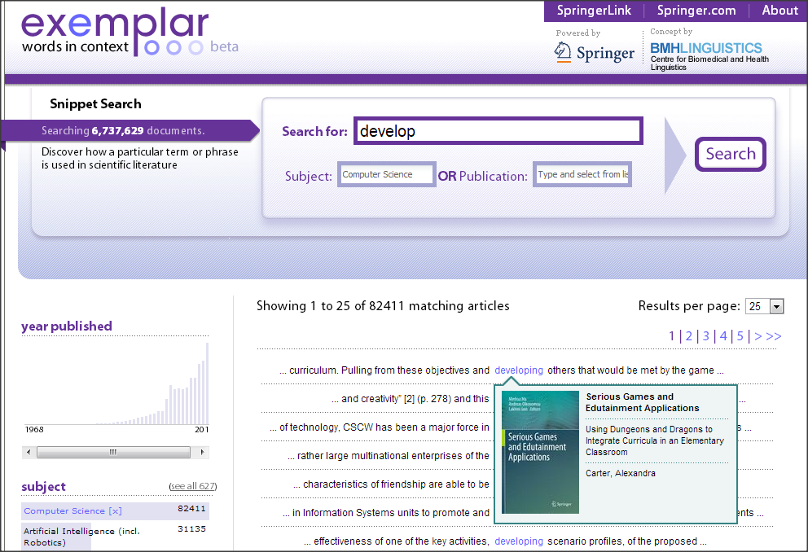
www.springerexemplar.com

Slide 34
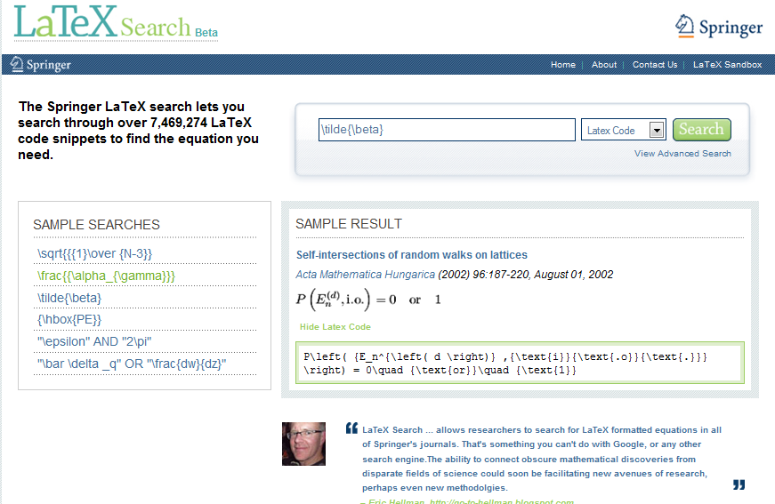
www.LaTeXSearch.com

Slide 35
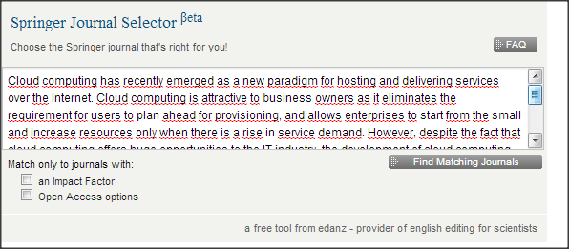
http://springer.journal-advisor.com

Slide 36
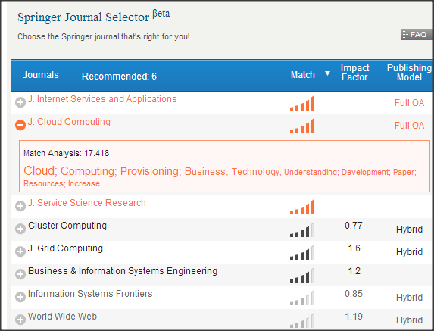
http://springer.journal-advisor.com
http://www.springer.com/authors/journal+authors/journal+authors+academy

